Slide 1


E-COMMERCE SALES ANALYSIS USING EXCEL AND SQL
MAINPROJECT
SUMBITTED BY :
TEAM 1

Slide 2

INTRODUCTION
This project focuses on analyzing e-commerce sales, customers, products, and inventory data.
The dataset contains real-world business transactions and customer purchase information.
Excel was used for data cleaning, calculations, pivot tables, and dashboard creation.
SQL was used to query and analyze large volumes of data efficiently.
The project aims to convert raw data into meaningful business insights.
Various KPIs were created to evaluate business performance.
The final output helps management make data-driven decisions.

Slide 3

OBJECTIVES
To analyze sales performance across different product categories.
To identify high-value customers based on spending patterns.
To evaluate the impact of discounts on overall revenue.
To monitor inventory levels and identify stock shortages.
To measure customer purchasing behavior and trends.
To generate visual dashboards for easy business monitoring.
To provide actionable insights for improving profitability.

Slide 4
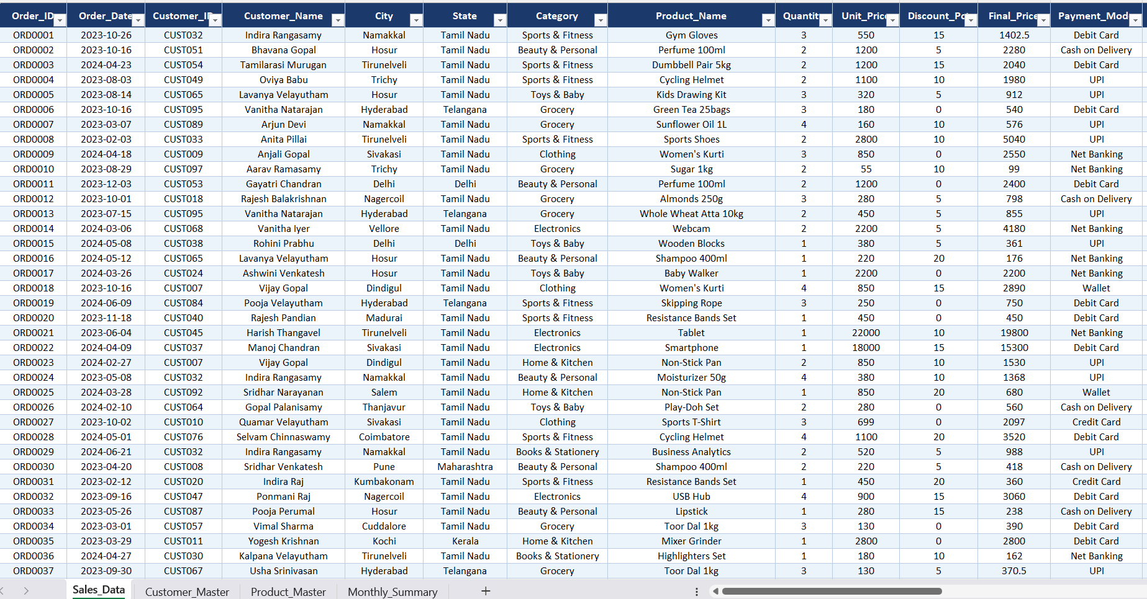
DATASET DESCRIPTION
The project uses an E-Commerce dataset consisting of customer, product, and sales information.
The Sales table contains transaction details such as order date, quantity, and revenue.
The Customer table contains customer demographics and purchasing history.
The Product table includes category, price, stock quantity, and ratings.
Monthly summary data is used for trend and performance analysis.
The dataset contains more than 500 records and multiple business attributes.
All tables are interconnected to support comprehensive analysis.

Slide 5
DATA CLEANING AND PREPROCESSING
RAW DATASET
Customer, Product, Sales data
NEW CALCULATED COLUMNS
Profit, Revenue, Customer level
MISSING VALUE CHECK
Identify null values
CLEAN DATASET READY
Ready for Analysis
DATA VALIDATION
Ensure accuracy and consistency
DUPLICATE REMOVAL
Remove repeated records
DATA FORMAT STANDARDIZATION
Correct date and number Formates

Slide 6
EXCEL ANALYSIS & FORMULA IMPLEMENTATAION
CLEAN DATASET
BULID PIVOT TABLES
Clean the dataset
Sales Summary, Customer Summary
APPLY FORMULAS
GENERATE CHARTS
Revenue Calculations, Discount Calculation, Profit estimation
Revenue Trend , Product Performance
CREATE NEW COLUMNS
CREATE DASHBOARDS
Customer Level, Age Group, Stock Status
Interactive KPIs,
Visual Analysis

Slide 7
SQL ANALYSIS PROCESS
Import Dataset
Create Tables
Import the given dataset
SELECT Queries
Revenue & profit Trends
Apply Filters
Customer table, Product Table, Sales Table
GROUP BY Analysis
Retrieve Data
Aggregate Functions
WHERE Clause Filter Records
Category Analysis
Business Insights
SUM()
AVG()
COUNT()

Slide 8
DASHBOARDS KPI STRUCTURE
SALES DATA
Total Revenue KPI measures overall business income.
Total Orders KPI tracks the number of customer transactions.
Average Order Value KPI evaluates customer spending behavior.
Top Selling Products KPI identifies best-performing products.
Return Rate KPI monitors product return performance.
Customer Segmentation KPI categorizes customers based on spending.
Inventory Status KPI helps prevent stock shortages and overstocking.
KPI CALCULATION
VISUALIZATION
PERFORMANCE TRACKING
DECISION MAKING

Slide 9
BUSINESS INSIGHTS
REVENUE BOX
Premium customers contribute a significant portion of total revenue.
Electronics and fashion categories generate the highest sales.
Discount campaigns increase customer purchase frequency.
Fast delivery positively impacts customer satisfaction.
Some products experience frequent stock shortages.
Customer retention is higher among loyalty program members.
Monthly sales trends reveal seasonal demand fluctuations.
CUSTOMER BOX
INVENTORY BOX
PRODUCT BOX
DELIVERY BOX

Slide 10
CONCLUSION & FUTURE SCOPE
Successfully performed end-to-end e-commerce data analysis.
Excel and SQL were effectively used for business intelligence tasks.
Interactive dashboards improved data visualization and reporting.
Business insights helped identify revenue and growth opportunities.
Inventory analysis supported better stock management decisions.
Future enhancements can include Power BI integration.
Machine Learning models can be implemented for sales forecasting and customer churn prediction.

